Slide 1
MEMORY ORGANIZATION
1
Memory Hierarchy
Main Memory
Auxiliary Memory
Associative Memory
Cache Memory
Virtual Memory
Memory Management Hardware

Slide 2
Memory Organization
2
Memory Hierarchy
MEMORY HIERARCHY
Memory Hierarchy is to obtain the highest possible
access speed while minimizing the total cost of the memory system
Auxiliary memory
Magnetic
tapes
I/O processor
Main memory
Magnetic
disks
CPU
Cache memory
Register
Cache
Main Memory
Magnetic Disk
Magnetic Tape

Slide 3
Memory Organization
3
Main Memory
MAIN MEMORY
RAM and ROM Chips
Typical RAM chip
Types of Memory
Static
Dynamic
Chip select 1
Chip select 2
Read
Write 7-bit address
 | CS1 CS2 _{RD} 128 x 8 _{WR} RAM AD 7
8-bit data bus
CS1 | CS2 | RD | WR | Memory function | State of data bus
0 | 0 | x | x | Inhibit | High-impedence
0 | 1 | x | x | Inhibit | High-impedence
1 1 | 0 0 | 0 0 | 0 1 | Inhibit Write | High-impedence Input data to RAM
1 1 | 0 1 | 1 x | x x | Read Inhibit | Output data from RAM High-impedence
Typical ROM chip
Uses of ROM
Bootstrap Loader
Computer Startup
Chip select 1
Chip select 2
CS1
CS2
512 x 8
ROM
8-bit data bus
9-bit address
AD 9

Slide 4
Memory Organization
4
Main Memory
MEMORY ADDRESS MAP
Address space assignment to each memory chip
Example: 512 bytes RAM and 512 bytes ROM
Component | Hexa | Address bus
 | address | 10 | 9 | 8 | 7 | 6 | 5 | 4 | 3 | 2 | 1
RAM 1 | 0000 - 007F | 0 0 0 0 1 | 0 0 1 1 x | 0 1 0 1 x | x x x x x | x x x x x | x x x x x | x x x x x | x x x x x | x x x x x | x x x x x
RAM 2 | 0080 - 00FF
RAM 3 | 0100 - 017F
RAM 4 | 0180 - 01FF
ROM | 0200 - 03FF
Memory Connection to CPU
- RAM and ROM chips are connected to a CPU
through the data and address buses
- The low-order lines in the address bus select the byte within the chips and other lines in the address bus select a particular chip through its chip select inputs

Slide 5
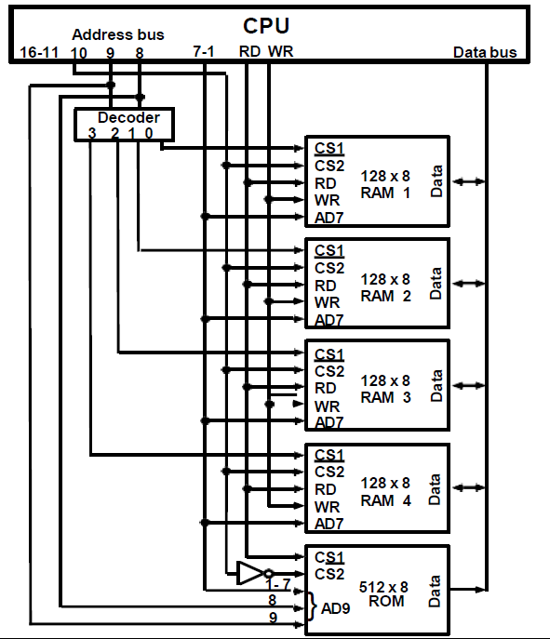
Memory Organization
5
Main Memory
CONNECTION OF MEMORY TO CPU

Slide 6
Memory Organization
6
Auxiliary Memory
AUXILIARY MEMORY
Information Organization on Magnetic Tapes
file i
block 1 block 2
EOF
Characteristics of Auxiliary Memory
R1 _{R2}
block 3
Access Mode
Access Time
Transfer rate
Capacity
Cost
R3 R4
R5
block 3 IRG
R5 R4
R6
EOF
R1
R3 R2
block 1
block 2
Access Time
Seek Time
Transfer Time
Organization of Disk Hardware
Moving Head Disk
Fixed Head Disk
Track

Slide 7

Memory Organization
7
ASSOCIATIVE MEMORY
Associative Memory
Accessed by the content of the data rather than by an address
Also called Content Addressable Memory (CAM)
Hardware Organization
A:
K:
101 111100
111 000000
Argument register(A)
Word 1: 100 111100 (No Match)
Word 2: 101 000001 (Match)
Key register (K)
Match register
Input
Associative memory array and logic
m words
n bits per word
M
Read
Write
Compare each word in CAM in parallel with the
content of A(Argument Register)
  If CAM Word[i] = A, M(i) = 1
  Read sequentially accessing CAM for CAM Word(i) for M(i) = 1
K(Key Register) provides a mask for choosing a particular field or key in the argument in A (only those bits in the argument that have 1’s in
their corresponding position of K are compared)

Slide 8
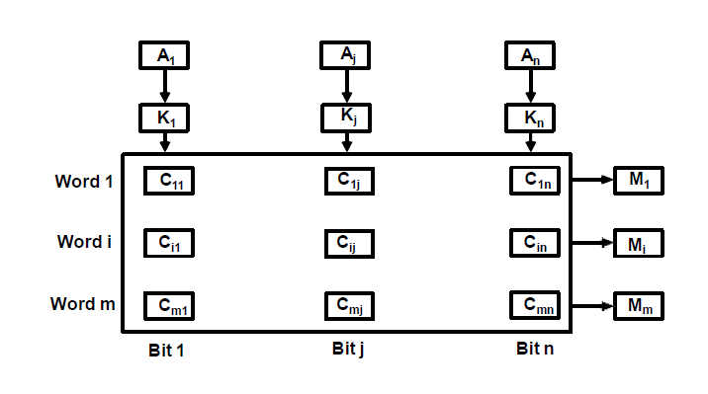
Memory Organization
8
Associative Memory
ORGANIZATION OF CAM

Slide 9



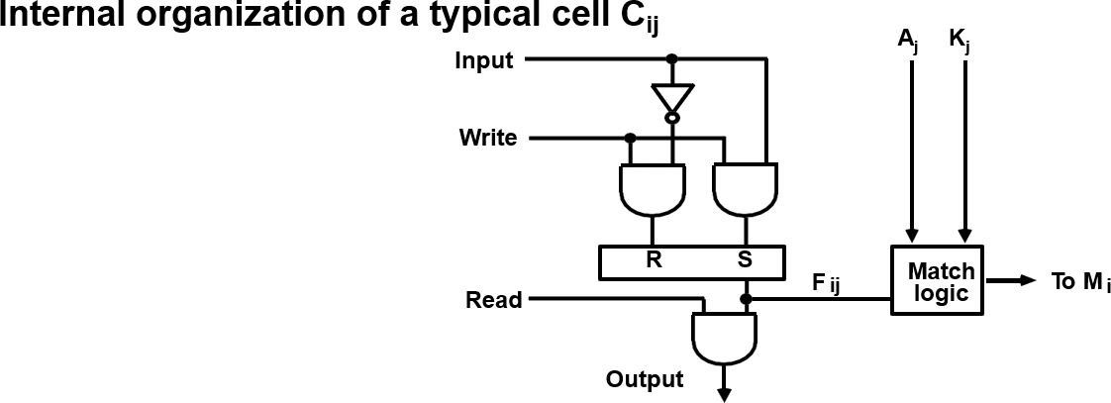
Memory Organization
9
Associative Memory
MATCH
LOGIC
𝒙_{𝒋} = 𝑨_{𝒋}𝑭_{𝒊𝒋} + 𝑨′𝑭′
𝒋 𝒊𝒋
𝑴_{𝒊} = 𝒙_{𝟏}𝒙_{𝟐}𝒙_{𝟑} … 𝒙_{𝒏}

Slide 10






Memory Organization
10
Associative Memory
MATCH
LOGIC
K₁
A₁
K₂
A₂
K_{n}
A_{n}
F'_{i1}
F i1
F'_{i2}
^{F} i2
. . . .
F'in Fin
M _{i}

Slide 11
Memory Organization
11
Cache Memory
CACHE MEMORY
Locality of Reference
The references to memory at any given time
interval tend to be confined within a localized areas
This area contains a set of information and
the membership changes gradually as time goes by
Temporal Locality
The information which will be used in near future
is likely to be in use already( e.g. Reuse of information in loops)
Spatial Locality
If a word is accessed, adjacent(near) words are likely accessed soon (e.g. Related data items (arrays) are usually stored together; instructions are executed sequentially)
Cache
The property of Locality of Reference makes the
Cache memory systems work
Cache is a fast small capacity memory that should hold those information which are most likely to be accessed
Main memory
CPU
Cache memory

Slide 12
Memory Organization
12
Cache Memory
PERFORMANCE OF CACHE
Memory Access
All the memory accesses are directed first to Cache
If the word is in Cache; Access cache to provide it to CPU
If the word is not in Cache; Bring a block (or a line) including
that word to replace a block now in Cache
How can we know if the word that is required
is there ?
If a new block is to replace one of the old blocks, which one should we choose ?
Performance of Cache Memory System
Hit Ratio - % of memory accesses satisfied by Cache memory system Te: Effective memory access time in Cache memory system
Tc: Cache access time
Tm: Main memory access time
Te = Tc + (1 - h) Tm
Example: Tc = 0.4 μs, Tm = 1.2μs, h = 0.85
Te = 0.4 + (1 - 0.85) * 1.2 = 0.58μs

Slide 13

Memory Organization
12
Cache Memory
MEMORY AND CACHE | MAPPING - ASSOCIATIVE MAPPLING -
Mapping Function Specification of correspondence between main memory blocks and cache blocks Associative mapping Direct mapping Set-associative mapping Associative Mapping Any block location in Cache can store any block in memory -> Most flexible Mapping Table is implemented in an associative memory -> Fast, very Expensive Mapping Table Stores both address and the content of the memory word address (15 bits) Argument register Address Data
CAM | 0 1 0 0 0 | 3 4 5 0
 | 0 2 7 7 7 | 6 7 1 0
 | 2 2 2 3 5 | 1 2 3 4

Slide 14
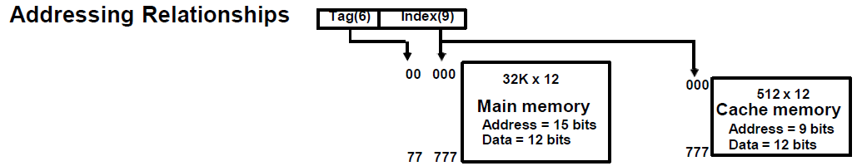
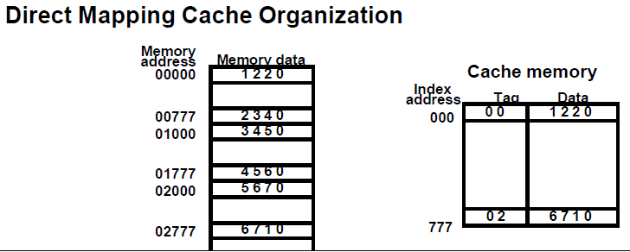
Memory Organization
13
Cache Memory
MEMORY AND CACHE MAPPING-DIRECT MAPPING
-Each memory block has only one place to load in Cache
-Mapping Table is made of RAM instead of CAM
-n-bit memory address consists of 2 parts' bits of Index field and n-k bits of Tag field
-n-bit addresses are used to access main memory and k-bit Index is used to access the Cache

Slide 15
Memory Organization
14
Cache Memory
DIRECT MAPPING
Operation
CPU generates a memory request with (TAG;INDEX)
Access Cache using INDEX ; (tag;
data) Compare TAG and tag
If matches -> Hit
Provide Cache[INDEX](data) to CPU
If not match -> Miss
M[tag;INDEX] <- Cache[INDEX](data)
Cache[INDEX] <- (TAG;M[TAG; INDEX])
CPU <- Cache[INDEX](data)
Direct Mapping with block size of 8 words
Index tag data 6
6
3
Block 0
000 007 | 0 1 0 1 | 3 4 5 0 6 5 7 8
010 017
770 777 | 0 2 0 2 | 6 7 1 0
Tag | Block | Word
INDEX
Block 1
Block 63

Slide 16
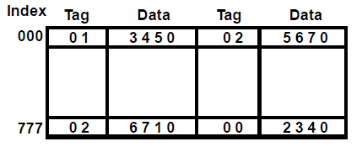
MEMORY AND CACHE MAPPING - SET ASSOCIATIVE MAPPING -
Memory Organization 15 Cache Memory
- Each memory block has a set of locations in the Cache to load
Set Associative Mapping Cache with set size of two
Operation
CPU generates a memory address(TAG; INDEX)
Access Cache with INDEX, (Cache word = (tag 0, data 0); (tag 1, data 1))
Compare TAG and tag 0 and then tag 1
If tag i = TAG -> Hit, CPU <- data i
If tag i ≠ TAG -> Miss,
Replace either (tag 0, data 0) or (tag 1, data 1), Assume (tag 0, data 0) is selected for replacement, (Why (tag 0, data 0) instead of (tag 1, data 1) ?)
M[tag 0, INDEX] <- Cache[INDEX](data 0) Cache[INDEX](tag 0, data 0) <- (TAG, M[TAG,INDEX]),
CPU <- Cache[INDEX](data 0)

Slide 17
Memory Organization
16
Cache Memory
BLOCK REPLACEMENT POLICY
Many different block replacement policies are available
LRU(Least Recently Used) is most easy to implement
Cache word = (tag 0, data 0, U0);(tag 1, data 1, U1), Ui = 0 or 1(binary)
Implementation of LRU in the Set Associative Mapping with set size = 2
Modifications
Initially all U0 = U1 = 1
When Hit to (tag 0, data 0, U0), U1 <- 1(least recently used) (When Hit to (tag 1, data 1, U1), U0 <- 1(least recently used)) When Miss, find the least recently used one(Ui=1)
If U0 = 1, and U1 = 0, then replace (tag 0, data 0)
M[tag 0, INDEX] <- Cache[INDEX](data 0)
Cache[INDEX](tag 0, data 0, U0) <- (TAG,M[TAG,INDEX], 0); U1 <- 1
If U0 = 0, and U1 = 1, then replace (tag 1, data 1)
Similar to above; U0 <- 1
If U0 = U1 = 0, this condition does not exist If U0 = U1 = 1, Both of them are candidates,
Take arbitrary selection

Slide 18
Memory Organization
17
Cache Memory
CACHE WRITE
Write Through
When writing into memory
If Hit, both Cache and memory is written in parallel
If Miss, Memory is written
For a read miss, missing block may be overloaded onto a cache block
Memory is always updated
-> Important when CPU and DMA I/O are both executing
Slow, due to the memory access time
Write-Back (Copy-Back)
When writing into memory
If Hit, only Cache is written
If Miss, missing block is brought to Cache and write into Cache
For a read miss, candidate block must be
written back to the memory
Memory is not up-to-date, i.e., the same item in
Cache and memory may have different value

Slide 19
Memory Organization
18
Virtual Memory
VIRTUAL MEMORY
Give the programmer the illusion that the system has a very large memory,
even though the computer actually has a relatively small main memory
Address Space(Logical) and Memory Space(Physical)
address space
memory space
virtual address (logical address)
Mapping
physical address
address generated by programs actual main memory address
Address Mapping
Memory Mapping Table for Virtual Address -> Physical Address
Virtual address
Memory mapping table
Main memory
Virtual address register
Main memory address register
Physical
Address
Memory table
buffer register
Main memory
buffer register

Slide 20
Memory Organization
19
Virtual Memory
ADDRESS MAPPING
Address Space and Memory Space are each divided into fixed size group of words called blocks or pages
1K words group
Page 0
Page 1
Page 2
Page 3
Page 4
Page 5
Page 6
Page 7
Address space N = 8K = 2¹³
Memory space
M = 4K = 2¹²
Block 0
Block 1
Block 2
Block 3
Organization of memory Mapping Table in a paged system
Page no. Line number
1 0 1
0 1 0 1 0 1 0 0 1 1
Virtual address
Table address
Presence
bit
000
 |  | 0
11 |  | 1
00 |  | 1
 |  | 0
 |  | 0
01 |  | 1
10 |  | 1
 |  | 0
Main memory
001
010
011
100
101
110
111
Block 0
Block 1
Block 2
Block 3
0 1
0 1 0 1 0 1 0 0 1 1
Main memory address register
Memory page table
MBR
01
1

Slide 21
ASSOCIATIVE MEMORY PAGE TABLE
Memory Organization 20
Virtual Memory
Assume that
Number of Blocks in memory = m
Number of Pages in Virtual Address Space = n
Page Table
- Straight forward design -> n entry table in memory
Inefficient storage space utilization
<- n-m entries of the table is empty
- More efficient method is m-entry Page Table Page Table made of an Associative Memory m words; (Page Number:Block Number)
Virtual address
Page no.
1 0 1 Line number Argument register
1 0 1 0 0 Key register
Associative memory
0 | 0 | 1 | 1 | 1
0 | 1 | 0 | 0 | 0
1 | 0 | 1 | 0 | 1
1 | 1 | 0 | 1 | 0
Page no.Block no.
Page Fault
Page number cannot be found in the Page Table

Slide 22
Memory Organization
21
Virtual Memory
PAGE FAULT
3 Page is on backing store
Trap to the OS
Save the user registers and program state
Determine that the interrupt was a page fault
Check that the page reference was legal and
determine the location of the page on the
backing store(disk)
Issue a read from the backing store to a free
frame
  Wait in a queue for this device until serviced
  Wait for the device seek and/or latency time
  Begin the transfer of the page to a free frame
While waiting, the CPU may be allocated to
some other process
Interrupt from the backing store (I/O completed)
OS
2
trap
LOAD M
1 Reference
6
restart
instruction
0
 | free frame
4
bring in missing page
5
reset page table
Save the registers and program state for the other user
Determine that the interrupt was from the backing store
Correct the page tables (the desired page is now in memory)
Wait for the CPU to be allocated to this process again
Restore the user registers, program state, and new page table, then resume the interrupted instruction.
main memory
Processor architecture should provide the ability
to restart any instruction after a page fault.

Slide 23
Memory Organization
22
Virtual Memory
PAGE REPLACEMENT
Decision on which page to displace to make room for an incoming page when no free frame is available
Modified page fault service routine
Find the location of the desired page on the backing store
Find a free frame
  If there is a free frame, use it
  Otherwise, use a page-replacement algorithm to select a victim
  Write the victim page to the backing store
Read the desired page into the (newly) free frame
frame
4. Restart the user process
valid/ invalid bit
victim
frame
swap out
1 victim
page
f 0 | v i
f | v
² change to
invalid
4
reset page table for new page
3
swap desired page in
page table
backing store
physical memory

Slide 24
PAGE REPLACEMENT ALGORITHMS
Memory Organization 23
Virtual Memory
FIFO
Reference string
7 0 1 2 0 3 0 4 2 3 0 3 2 1 2 0 1 7 0 1
7
7
0
7
0
1
2
0
1
2
3
1
2
3
0
4
3
0
4
2
0
4
2
3
0
2
3
0
1
3
0
1
2
7
1
2
7
0
2
7
0
1
Page frames
FIFO algorithm selects the page that has been in memory the longest time
Using a queue - every time a page is loaded, its
identification is inserted in the queue
-
Easy to implement
May result in a frequent page fault
Optimal Replacement (OPT) - Lowest page fault rate of all algorithms
Replace that page which will not be used for the longest period of time
Reference string
7 0 1 2 0 3 0 4 2 3
0 3 2 1 2 0
1 7 0 1
7
7
0
7
0
1
2
0
1
2
0
3
2
4
3
2
0
3
2
0
1
7
0
1
Page frames

Slide 25
PAGE REPLACEMENT ALGORITHMS
Memory Organization 24
Virtual Memory
LRU
OPT is difficult to implement since it requires future knowledge
LRU uses the recent past as an approximation of near future.
Replace that page which has not been
used for the longest period of time
Reference string
7 0 1 2 0 3 0 4 2 3 0 3 2 1 2 0 1 7 0 1
7
7
0
7
0
1
2
0
1
2
0
3
4
0
3
4
0
2
4
3
2
0
3
2
1
3
2
1
0
2
1
0
7
Page frames
LRU may require substantial hardware assistance
The problem is to determine an order for the frames
defined by the time of last use

Slide 26
PAGE REPLACEMENT ALGORITHMS
Memory Organization 25
Virtual Memory
LRU Implementation Methods
Counters
  For each page table entry - time-of-use register
  Incremented for every memory reference
  Page with the smallest value in time-of-use register is replaced
Stack
  Stack of page numbers
  Whenever a page is referenced its page number is removed from the stack and pushed on top
  Least recently used page number is at the bottom
Reference string
4 7 0 7 1 0 1 2 1 2 7 1 2
2
1
0
7
4
7
2
1
0
4
LRU Approximation
Reference (or use) bit is used to approximate the LRU
Turned on when the corresponding page is
referenced after its initial loading
Additional reference bits may be used

Slide 27
MEMORY MANAGEMENT HARDWARE
Memory Organization 26 Memory Management Hardware
Basic Functions of MM
Dynamic Storage Relocation - mapping logical
memory references to physical memory references
Provision for Sharing common information
stored in memory by different users
Protection of information against unauthorized access
Segmentation
- A segment is a set of logically related instructions or data elements associated with a given name
- Variable size
User's view of memory
The user does not think of memory as a linear array of words. Rather the user prefers to view memory as a collection of variable sized segments, with no necessary ordering among segments.
Stack
Subroutine
Symbol Table
SQRT
Main
Program
User's view of a program

Slide 28
Memory Organization
27
Memory Management Hardware
SEGMENTATION
A memory management scheme which supports
user's view of memory
A logical address space is a collection of segments
Each segment has a name and a length
Address specify both the segment name and the offset within the segment.
For simplicity of implementations, segments are numbered.
Segmentation Hardware
Segment Table
s
limit
base
CPU
(s,d)
Memory
<
y
+
n
error

Slide 29


SEGMENTATION EXAMPLE
Memory Organization
28 Memory Management Hardware
Segment 0
Segment 3
Segment 2
Segment 4
Segment 1
Subroutine
Segment 0
Stack
Segment 3
1400
2400
Symbol Table
Segment 4
3200
SQRT
Segment 1
Main
Program
Segment 2
4300
4700
Logical Address Space
5700
6300
6700
Segment Table
limit | base
1000 400 400 1100 1000 | 1400 6300 4300 3200 4700
0
1
2
3
4

Slide 30



SHARING OF SEGMENTS
Memory Organization
29 Memory Management Hardware
Editor
Editor
Data 1
Data 2
limit | base
25286 | 43062
4425 | 68348
43062
Segment 0
0
1
Data 1
Segment Table
(User 1)
68348
72773
Segment 1
Logical Memory
(User 1)
90003
98556
Editor
limit | base
25286 | 43062
8550 | 90003
0
1
Segment 0
Physical Memory
Data 2
Segment Table (User 2)
Segment 1
Logical Memory
(User 2)

Slide 31
SEGMENTED PAGE SYSTEM
Memory Organization
30 Memory Management Hardware
Logical address
Segment
Page
Word
Segment table
Page table
+
Block
Word
Physical address

Slide 32
IMPLEMENTATION OF PAGE AND SEGMENT TABLES
Memory Organization 31 Memory Management Hardware
Implementation of the Page Table
Hardware registers (if the page table is reasonably small)
Main memory
  Page Table Base Register(PTBR) points to PT
  Two memory accesses are needed to access
a word; one for the page table, one for the word
- Cache memory (TLB: Translation Lookaside Buffer)
- To speedup the effective memory access time, a special small memory called associative memory, or cache is used
Implementation of the Segment Table Similar to the case of the page table

Slide 33
Memory Organization
32
Memory Management Hardware
EXAMPLE
Logical and Physical Addresses
Logical address format: 16 segments of 256 pages
each, each page has 256words
4 8 8
Segment | Page | Word
2²⁰ x 32
Physical
memory
Physical address format: 4096 blocks of 256 words
each, each word has 32bits
12 8
Block Word
Logical and Physical Memory Address Assignment
Hexa
address
60000
60100
60200
60300
60400
604FF
Page number
Page 0
Page 1
Page 2
Page 3
Page 4
Segment Page | Block
6 00 6 01 6 02 6 03 6 04 | 012 000 019 053 A61
(a) Logical address assignment
(b) Segment-page versus
memory block assignment

Slide 34
LOGICAL TO PHYSICAL MEMORY MAPPING
Memory Organization 33 Memory Management Hardware
Segment and page table mapping
Logical address (in hexadecimal)
6 | 02 | 7E
Segment table
Page table
00000
000FF
Physical memory
0
35
A3
00
012
000
019
053
A61
012
Block 0
Block 12
32-bit word
6
35
36
37
38
39
01200
012FF
F
01900
0197E
019FF
A3
Associative memory mapping
Segment | Page | Block
6 | 02 | 019
6 | 04 | A61

Slide 35
Memory Organization
34
Memory Management Hardware
MEMORY PROTECTION
Protection information can be included in the
segment table or segment register of the memory
management hardware
- Format of a typical segment descriptor
Base address | Length | Protection
The protection field in a segment descriptor specifies
the Access Rights to the particular segment
In a segmented-page organization, each entry in the page table may have its own protection field to describe the Access Rights of each page
Full read and write privileges. Read only (write protection) Execute only (program protection) System only (O.S. Protection)
- Access Rights:

